Slide 1
ECE5584 Digital Image Processing: Homework 4 Image Restoration with Deep Learning Fall 2019
By Matthew Kayrish and Maiyue Zhang

Slide 2
Homework 4 Introduction
“In this work, we will try residual learning with VDSR like structure to restore images with corruption from both pixel independent i.i.d additive noises, as well as pixel dependent PSF induced noises. Use the following program to generate noisy images…[We utilized PyCharm & PyTorch. This program is not applicable. The results still work.]
The data set to work on are two aerial remote sensing data set:
AID data set:https://captain-whu.github.io/AID/
NWPU RESISC 45: http://www.escience.cn/people/JunweiHan/NWPU-RESISC45.html

Slide 3
Homework 4 Requirements of Report
Your report must involve:
Introduction
Explanation of key lines
Hyper-parameters adjustment (learning rate, number of layers, etc..)
Training results on one dataset two types of noisy images:
The loss curve of training & validation set (figure)
The average PSNR curve of validation set (figure)
The results on testing set between wiener filer and VDSR in the comparison.
Result analysis
Conclusion

Slide 4
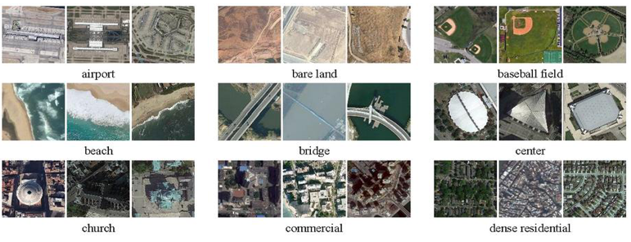
Homework 4 Introduction
AID data set: https://captain-whu.github.io/AID/

Slide 5
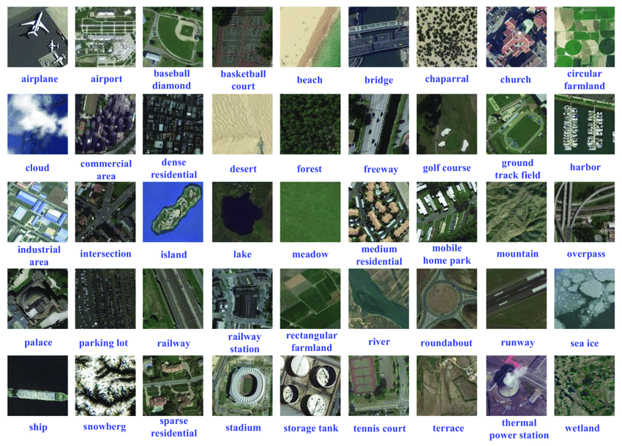
Homework 4 Introduction
NWPU RESISC 45: http://www.escience.cn/people/JunweiHan/NWPU-RESISC45.html

Slide 6
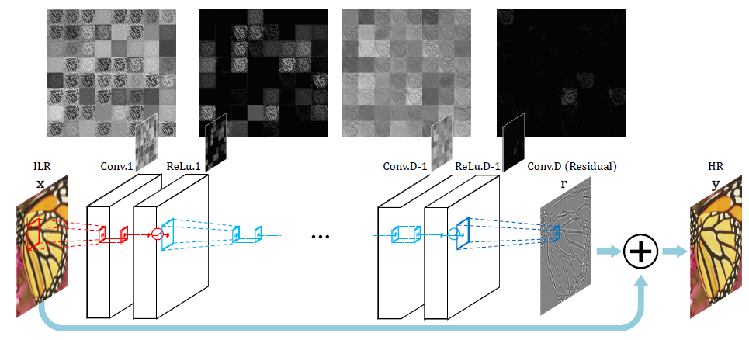
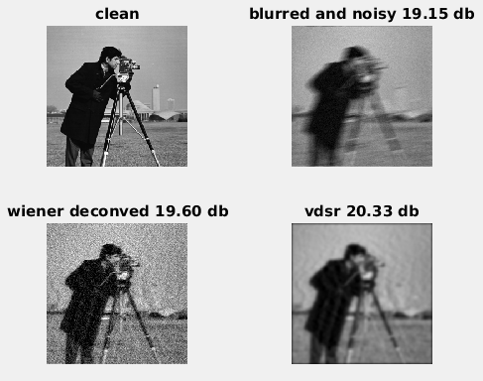
Homework 4 Requirements
Q1 [60pts]: Design a VDSR like residual learning network, with 4 and 8 residual blocks, and a predictor that is just Gaussian smoothing with sigma=2.0, i.e. your residual learning target, is im1 - imfilter(im1, h3) as in the example code;
Q2[40pts]: Show restoration results in the format below:

Slide 7
Homework 4 Requirements
Q1 [60pts]: Design a VDSR like residual learning network, with 4 and 8 residual blocks, and a predictor that is just Gaussian smoothing with sigma=2.0, i.e. your residual learning target, is im1 - imfilter(im1, h3) as in the example code;
Q2[40pts]: Show restoration results in the format below:
Your report must involve:
Introduction
Explanation of key lines
Hyper-parameters adjustment (learning rate, number of layers, etc..)
Training results on one dataset two types of noisy images:
The loss curve of training & validation set (figure)
The average PSNR curve of validation set (figure)
The results on testing set between wiener filer and VDSR in the comparison.
Result analysis
Conclusion

Slide 8
Training Code
Files involved in Training:
TrainHW4.py
Train.py
Model.py
Dataset.py
Utils.py
Noise_generator.py

Slide 9
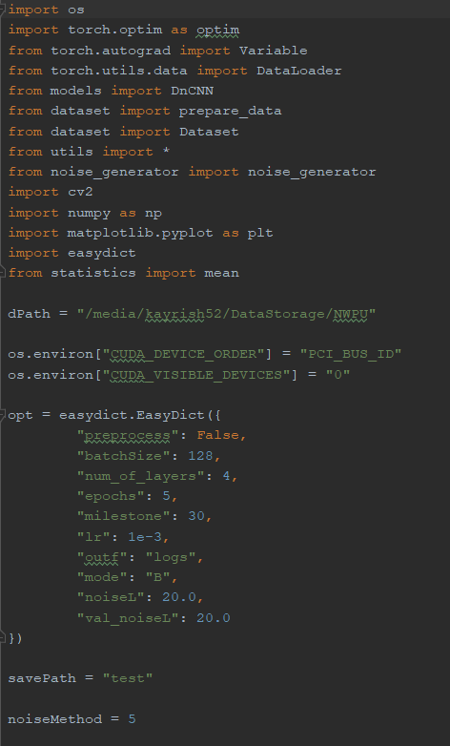
From Train.py
Include the needed packages
Set the location of training data
Tell the program HOW to find the GPU
Set the training parameters

Slide 10
From Train.py
Include the needed packages
Set the location of training data
Tell the program HOW to find the GPU
Set the training parameters
Depth equal 4 or 8 layers
Sigma = 20.0…Scaled by 10

Slide 11
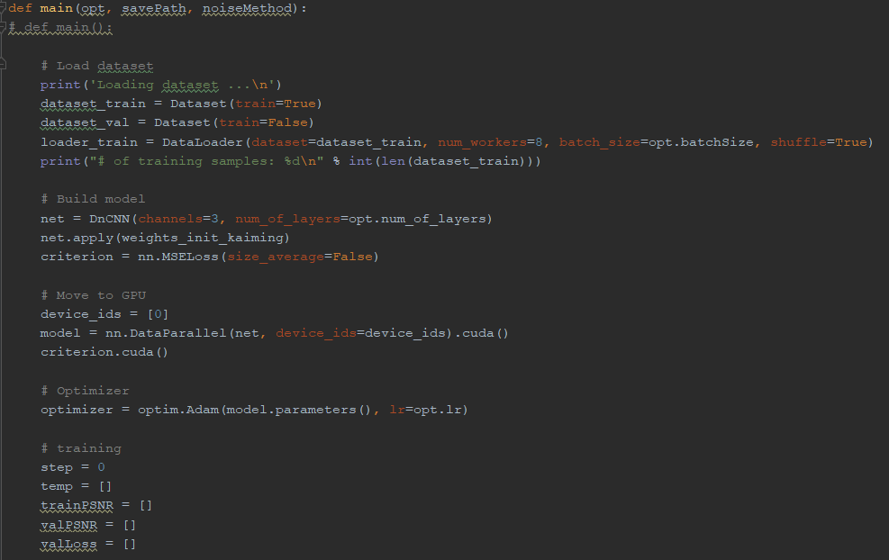
From Train.py
Load the data
Set the training data
Define the model as a DuCNN
Tell Python to use the GPU
Set the Optimizer
Initialize variables

Slide 12
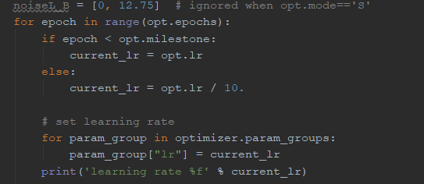
From Train.py
Set the noise
Set the learning rate
Set the training routine by setting
the epochs

Slide 13
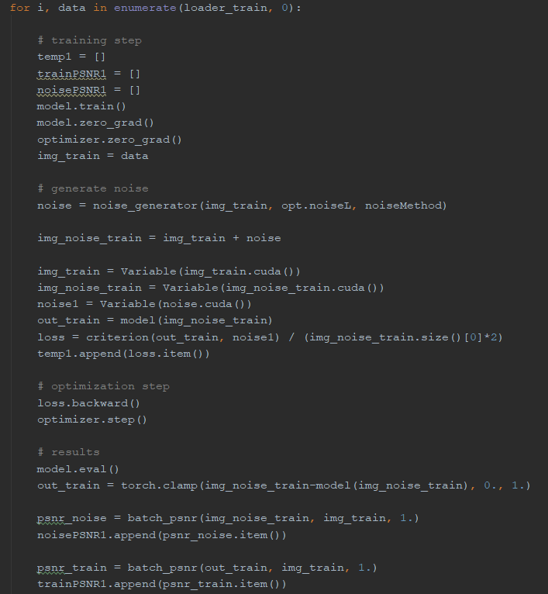
From Train.py
Initialize Tracking Parameters
Create Noise
Add noise to the image
Feed Noise to CNN
Tell GPU Model to perform model
training
Determine the original image vs
Image noise
Calculate the loss
Calculate the output of the CNN
Calculate the PSNR for noise
and training set

Slide 14
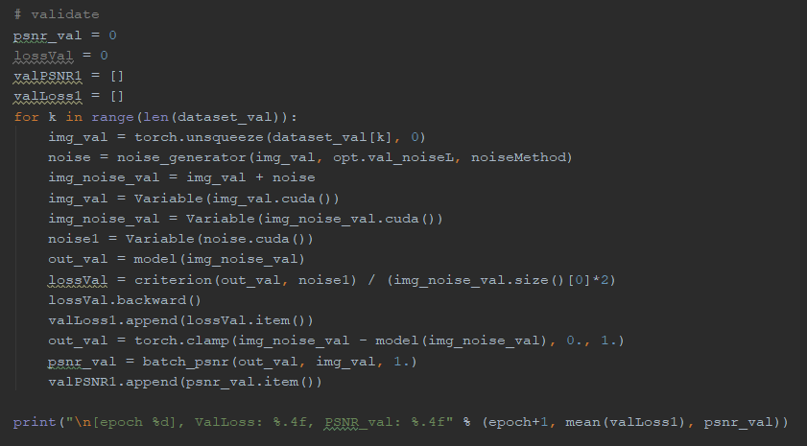
From Train.py
Convert the model to evaluation mode
Loop over the validation dataset
Call noise generation
Add noise to validation snapshot
Pass validation image through network
Calculate loss
Calculate the PSNR
Track all of the data

Slide 15
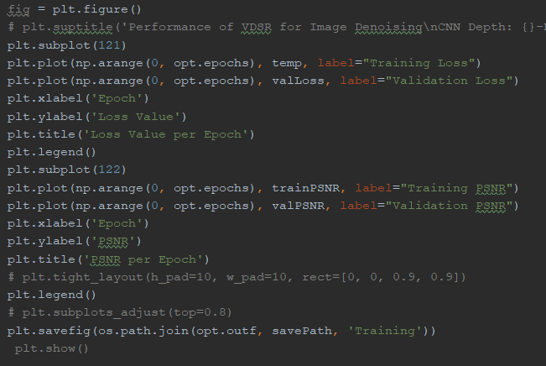
From Train.py
Plot the Training Loss and Validation Loss
Plot the PSNR for Training and Validation

Slide 16
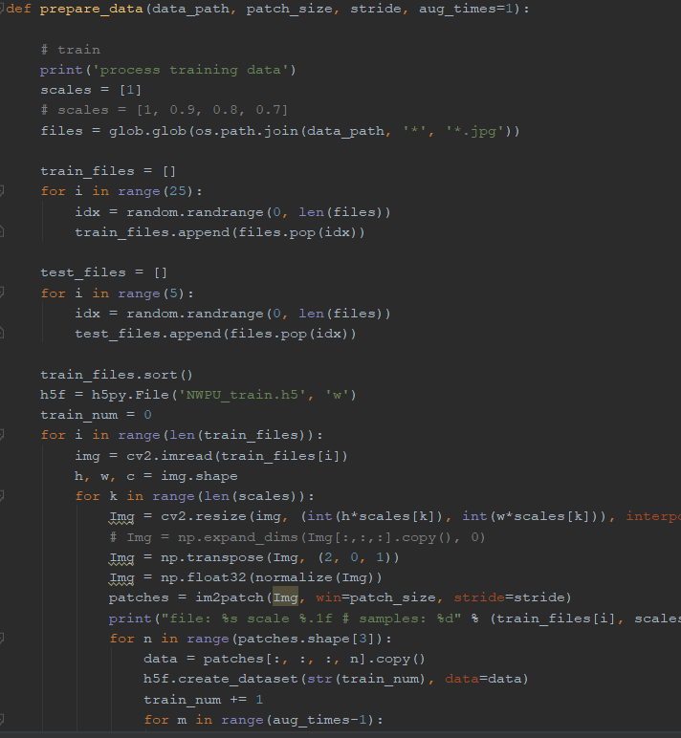
From Dataset.py
Prepare the training data
Select the training and validation data
Load the data as an image
Create patches for training
Augment the data
Save and close

Slide 17
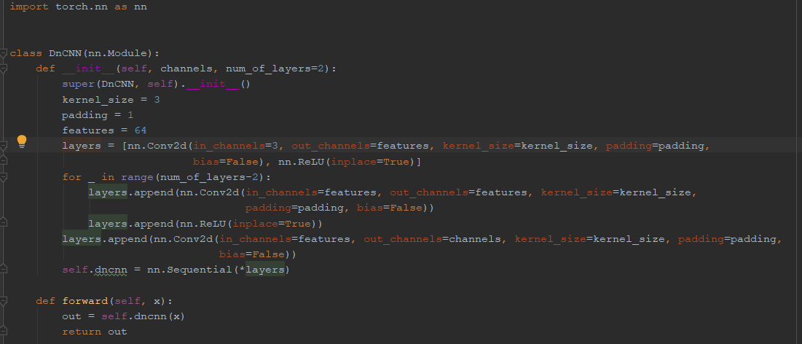
From Model.py
Class Module for the Deep Learning CNN.
Create and append convolutional layers
Create and append ReLU layers
Convert the added layers to ‘Sequential Layers’

Slide 18
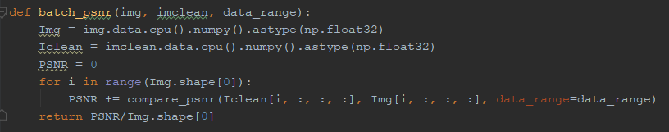
From Utils.py
Calculate the PSNR of individual images

Slide 19
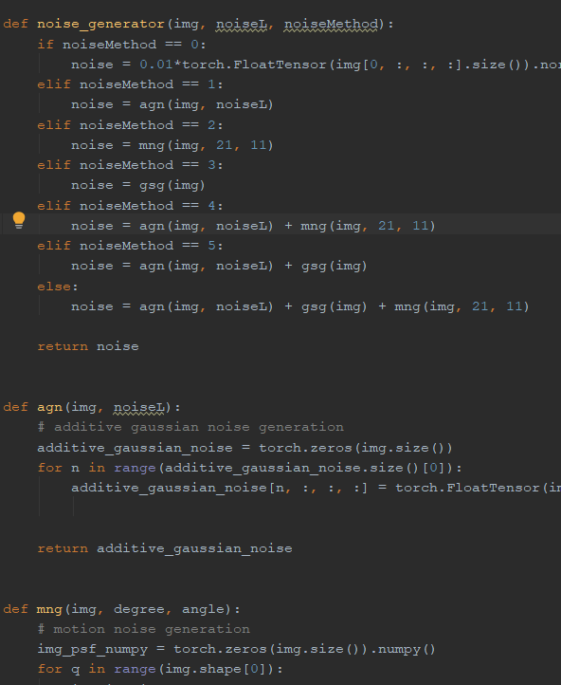
From noise_generator.py
Generate the appropriate noise characteristics to be added to the clean images

Slide 20
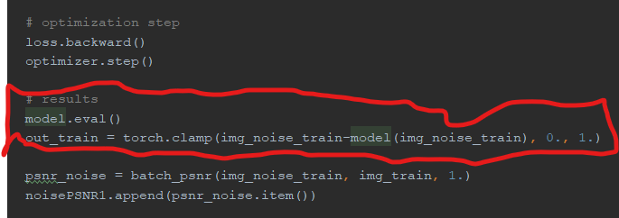
From Train.py
Calculate the output residual image from the designed network

Slide 21
Homework 4 Requirements
Q1 [60pts]: Design a VDSR like residual learning network, with 4 and 8 residual blocks, and a predictor that is just Gaussian smoothing with sigma=2.0, i.e. your residual learning target, is im1 - imfilter(im1, h3) as in the example code;
Q2[40pts]: Show restoration results in the format below:
Your report must involve:
Introduction
Explanation of key lines
Hyper-parameters adjustment (learning rate, number of layers, etc..)
Training results on one dataset two types of noisy images:
The loss curve of training & validation set (figure)
The average PSNR curve of validation set (figure)
The results on testing set between wiener filer and VDSR in the comparison.
Result analysis
Conclusion

Slide 22
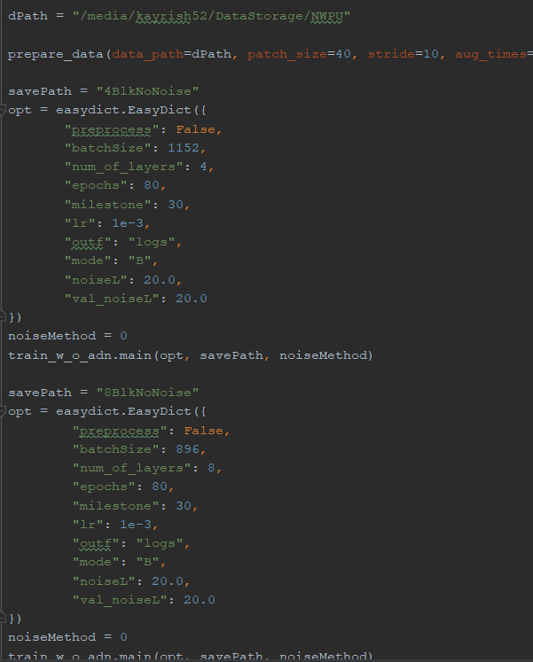
From TrainHW4.py
Design a VDSR network:
Hyper-parameters adjustment (learning rate, number of layers, etc..)
Various Runs:
4 vs 8 layers
1e-3 vs 1e-4 learning rates
30 epochs vs 100 vs 200 epochs
128 batch size vs [up to] 1152 for
NVIDIA 2070 SUPER

Slide 23
Homework 4 Requirements
Q1 [60pts]: Design a VDSR like residual learning network, with 4 and 8 residual blocks, and a predictor that is just Gaussian smoothing with sigma=2.0, i.e. your residual learning target, is im1 - imfilter(im1, h3) as in the example code;
Q2[40pts]: Show restoration results in the format below:
Your report must involve:
Introduction
Explanation of key lines
Hyper-parameters adjustment (learning rate, number of layers, etc..)
Training results on one dataset two types of noisy images:
The loss curve of training & validation set (figure)
The average PSNR curve of validation set (figure)
The results on testing set between wiener filer and VDSR in the comparison.
Result analysis
Conclusion

Slide 24
Training Parameters for the Next 16 Slides
Learning Rate: 1e-3
30 epochs
Noise Parameters:
No Noise
Additive Gaussian White (AGW) Noise Only
Motion Blurring Plus AGW
Gaussian Smoothing Plus AGW
Number of Training Samples:
500 Samples
100 Samples
50 Samples
25 Samples
Number of Convolutional Layers:
4 Blocks
8 Blocks

Slide 25
Training Parameters: Noise Parameters
For Additive Gaussian White Noise
Mean: 0
Std.: 2.0
For Motion Noise/Blurring
Angle from 0: 11
Length: 21
For Gaussian Smoothing Noise
Mean: 0
Std.: 2.0

Slide 26
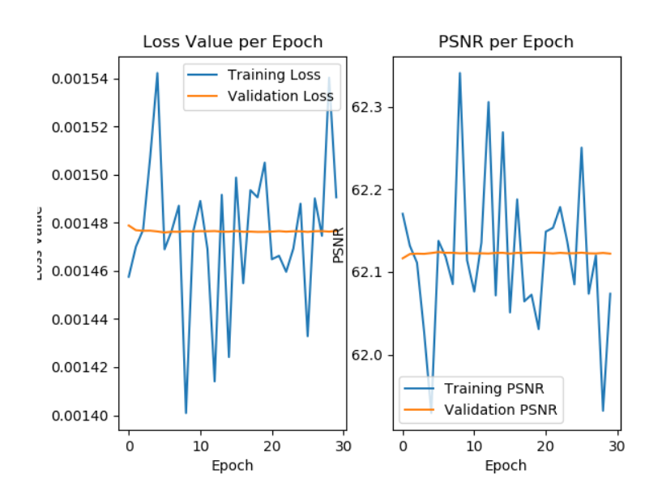
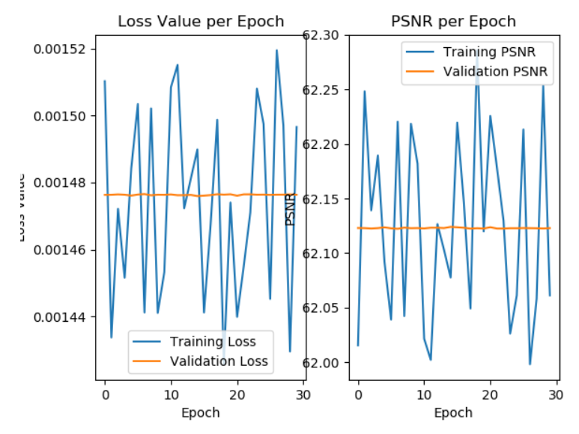
Training Results: 500 Training Images
No Noise: 4 Blocks vs 8 Blocks
4 Blocks
8 Blocks

Slide 27
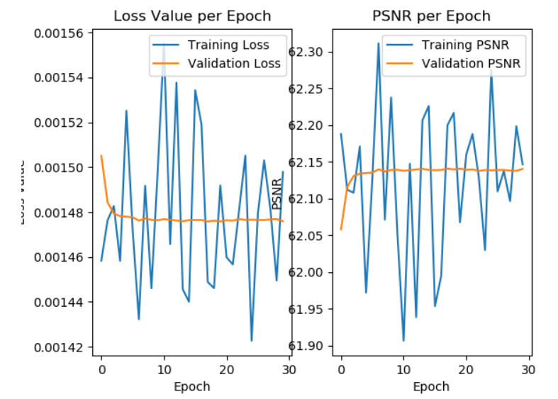
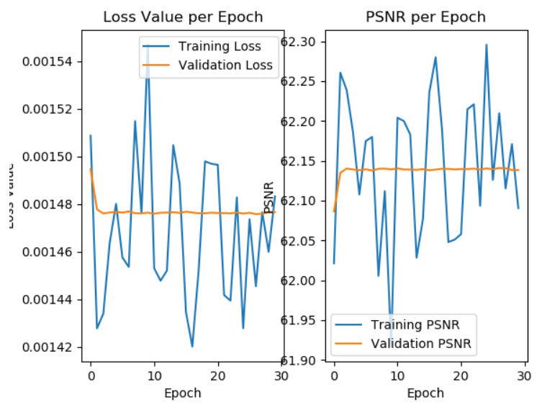
Training Results: 100 Training Images
No Noise: 4 Blocks vs 8 Blocks
4 Blocks
8 Blocks

Slide 28
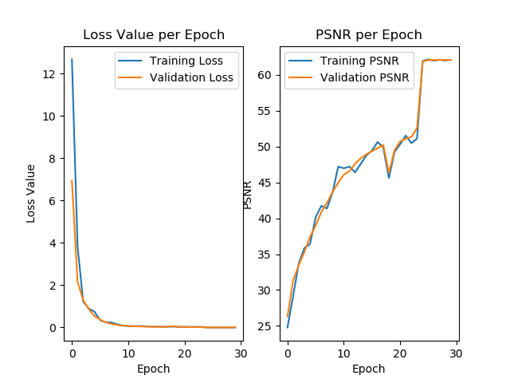
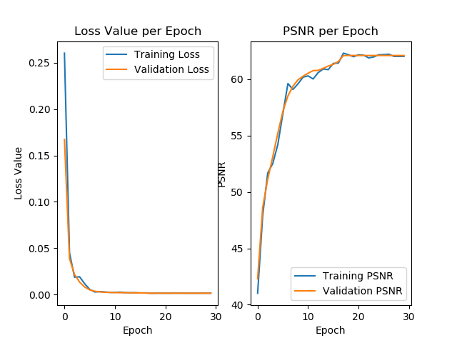
Training Results: 50 Training Images
No Noise: 4 Blocks vs 8 Blocks
4 Blocks
8 Blocks

Slide 29
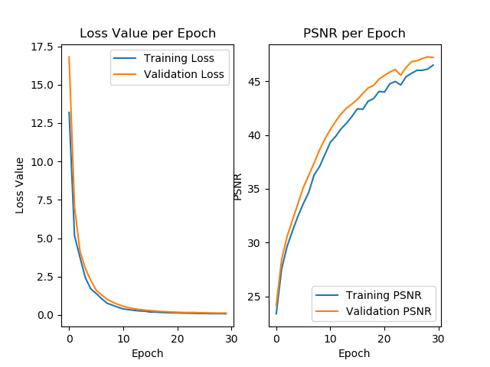
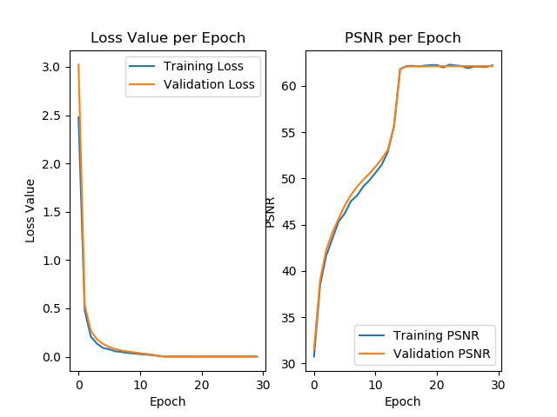
Training Results: 25 Training Images
No Noise: 4 Blocks vs 8 Blocks
4 Blocks
8 Blocks

Slide 30
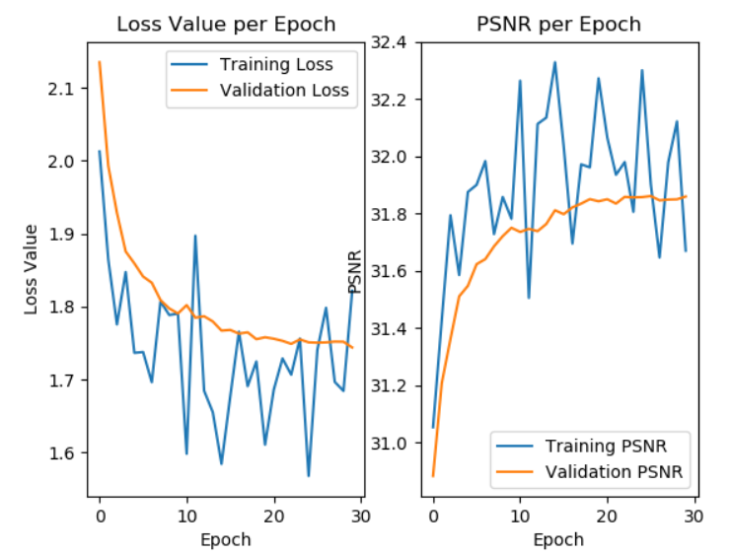
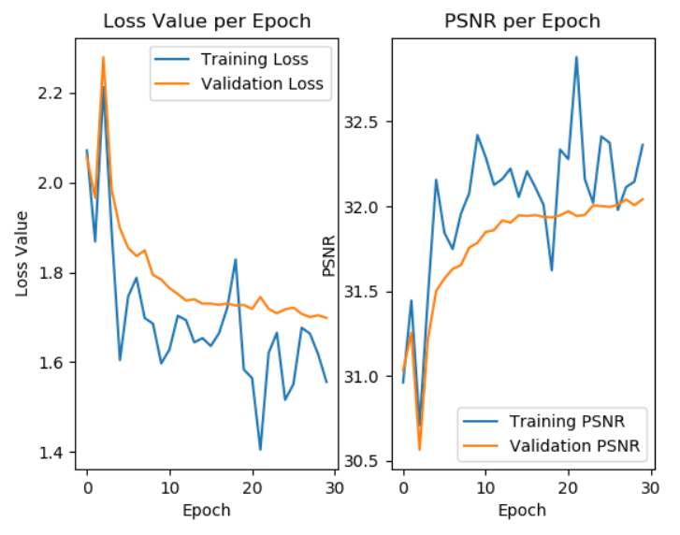
Training Results: 500 Training Images
Additive Noise Only: 4 Blocks vs 8 Blocks
4 Blocks
8 Blocks

Slide 31
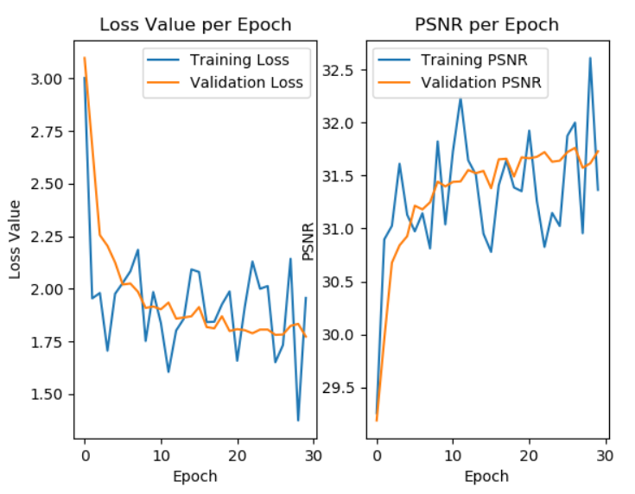
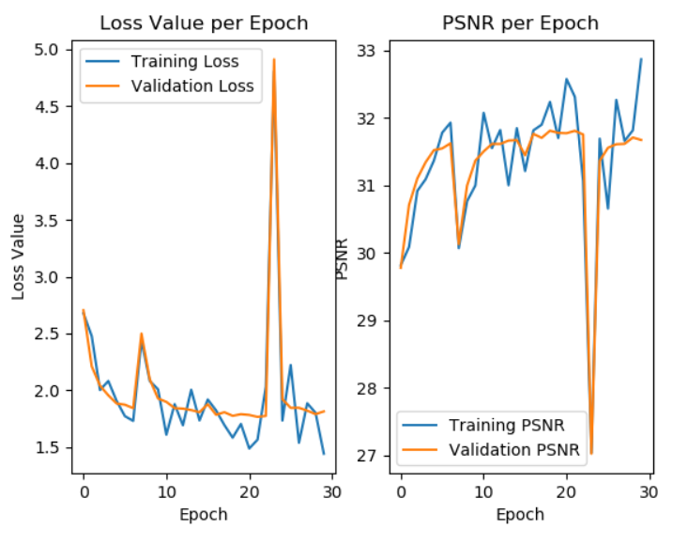
Training Results: 100 Training Images
Additive Noise Only: 4 Blocks vs 8 Blocks
4 Blocks
8 Blocks

Slide 32
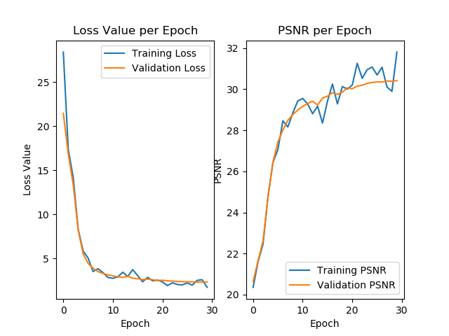
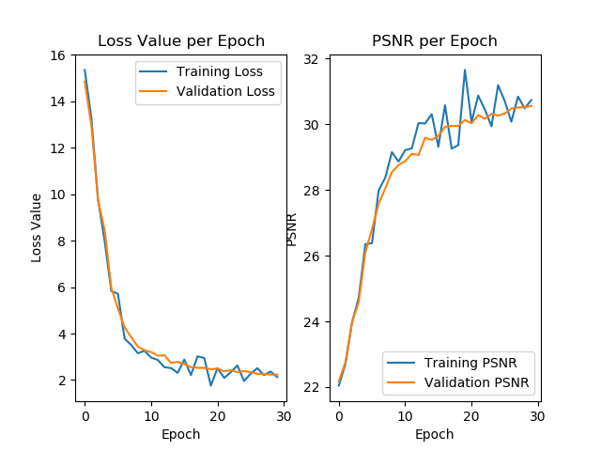
Training Results: 50 Training Images
Additive Noise Only: 4 Blocks vs 8 Blocks
4 Blocks
8 Blocks

Slide 33
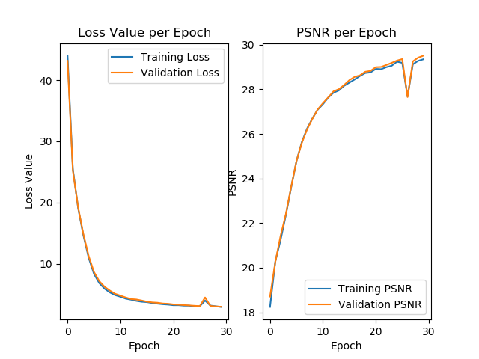
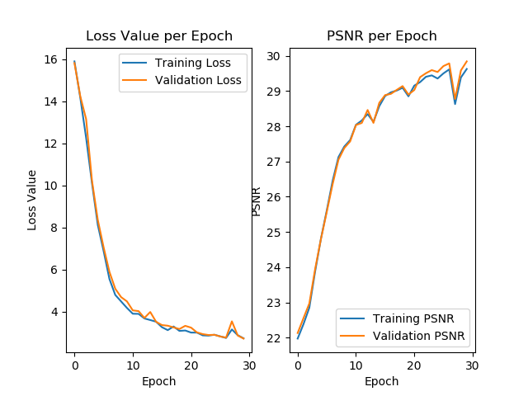
Training Results: 25 Training Images
Additive Noise Only: 4 Blocks vs 8 Blocks
4 Blocks
8 Blocks

Slide 34
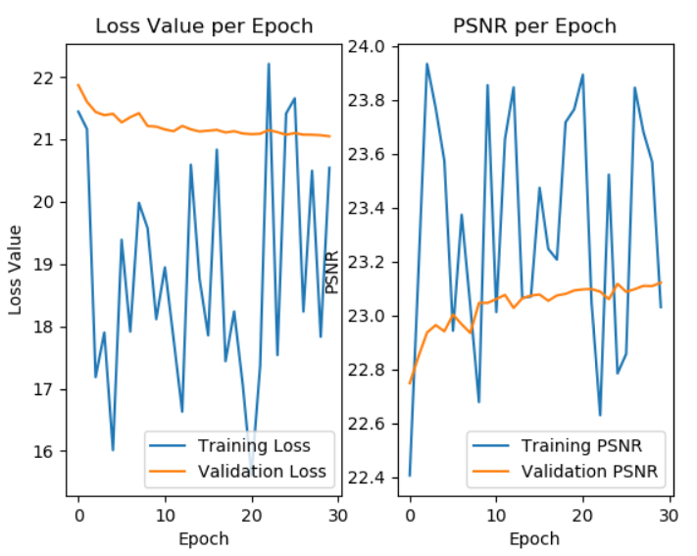
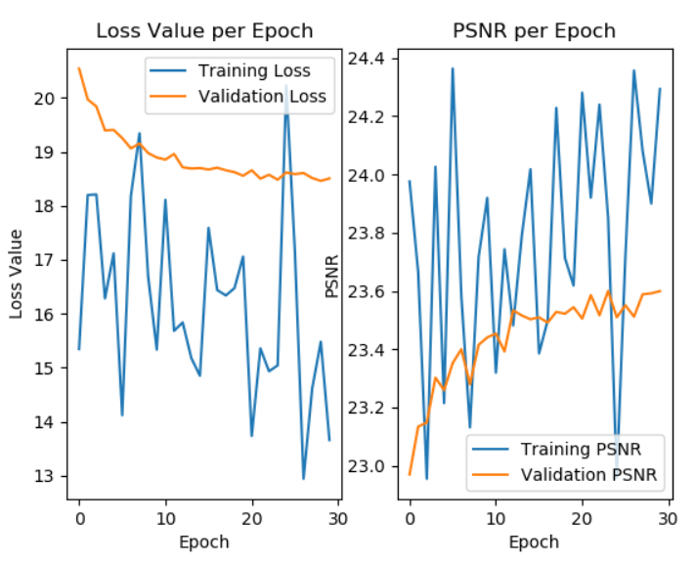
Training Results: 500 Training Images
Motion Plus Additive Noise: 4 Blocks vs 8 Blocks
4 Blocks
8 Blocks

Slide 35
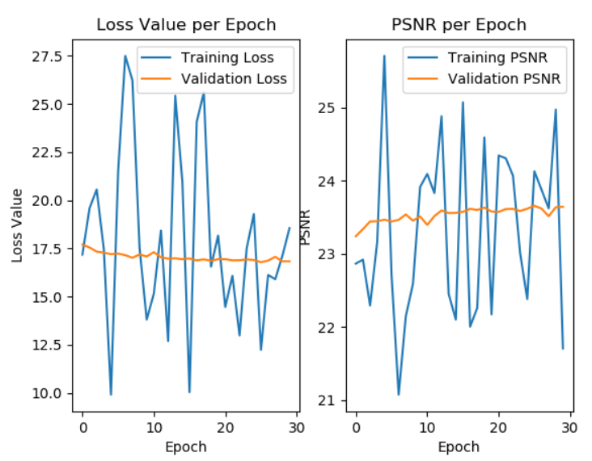
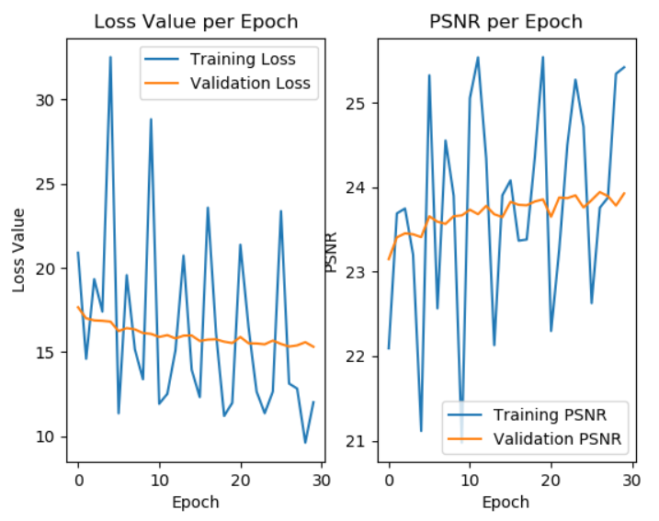
Training Results: 100 Training Images
Motion Plus Additive Noise: 4 Blocks vs 8 Blocks
4 Blocks
8 Blocks

Slide 36
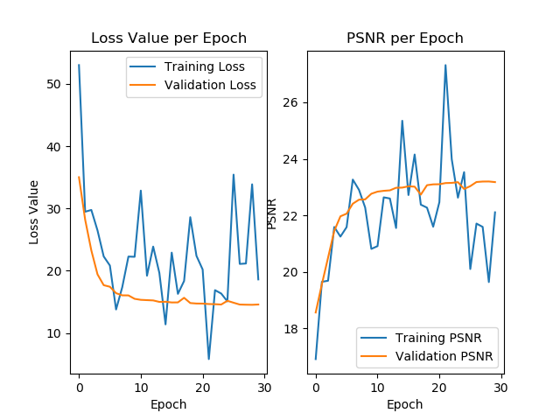
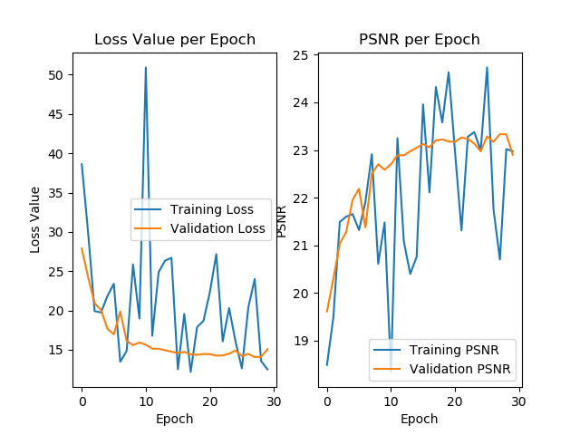
Training Results: 50 Training Images
Motion Plus Additive Noise: 4 Blocks vs 8 Blocks
4 Blocks
8 Blocks

Slide 37
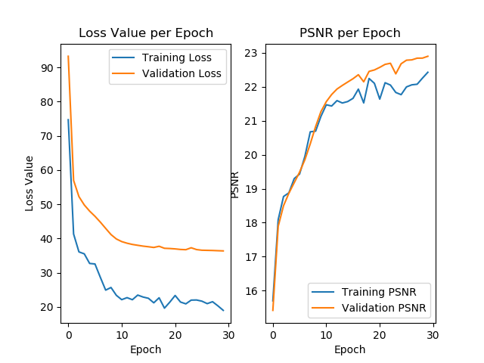
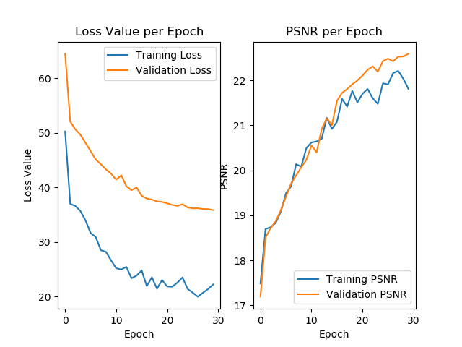
Training Results: 25 Training Images
Motion Plus Additive Noise: 4 Blocks vs 8 Blocks
4 Blocks
8 Blocks

Slide 38
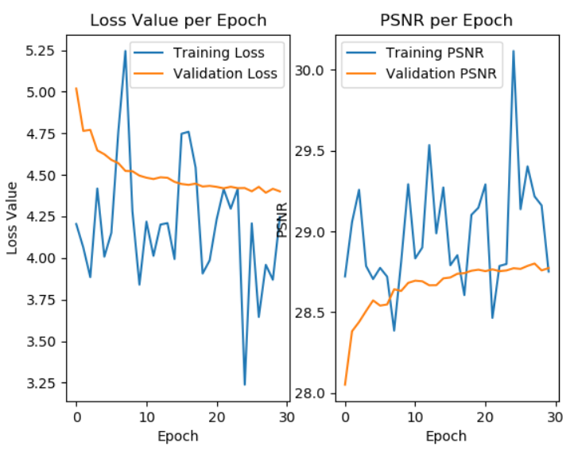
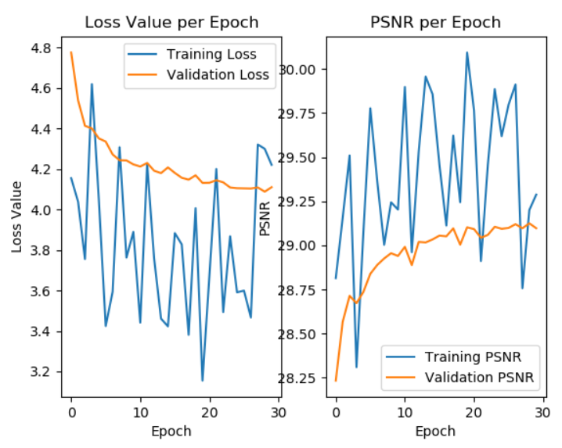
Training Results: 500 Training Images
Smoothing Plus Additive Noise: 4 Blocks vs 8 Blocks
4 Blocks
8 Blocks

Slide 39
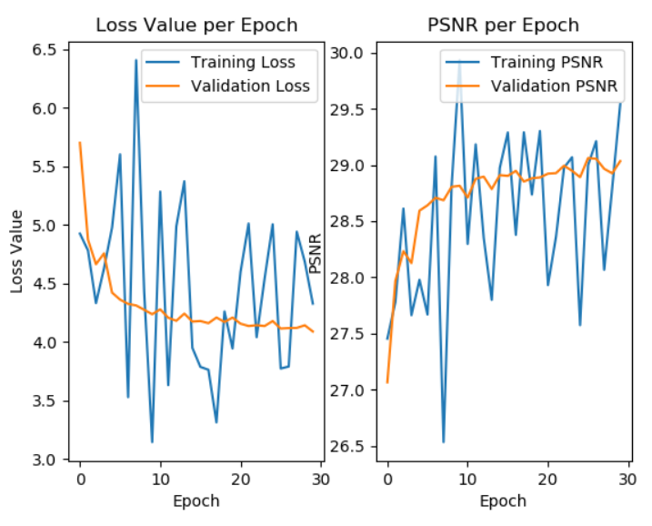
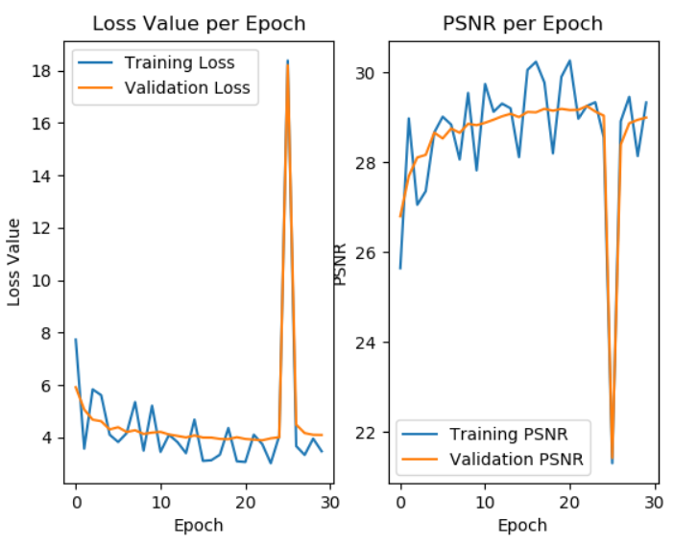
Training Results: 100 Training Images
Smoothing Plus Additive Noise: 4 Blocks vs 8 Blocks
4 Blocks
8 Blocks

Slide 40
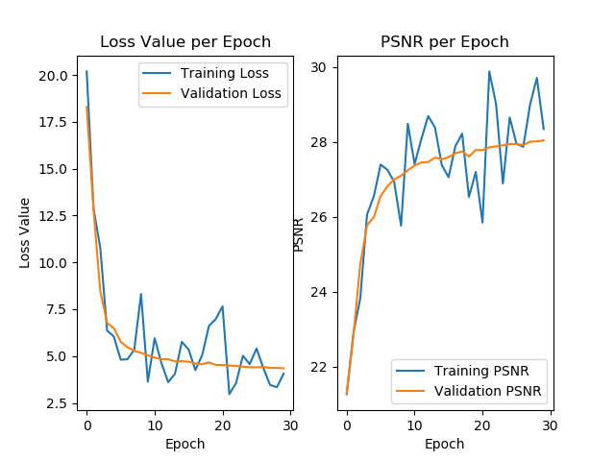
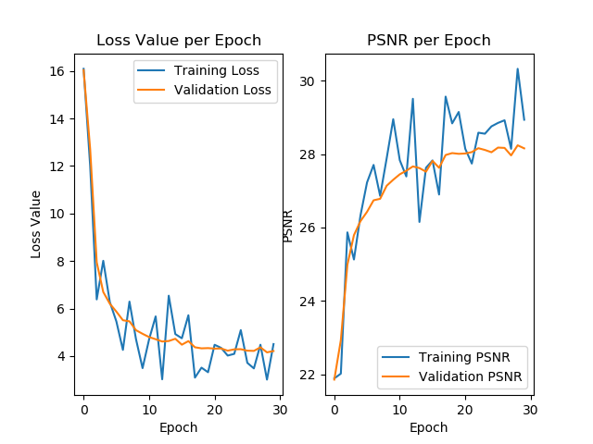
Training Results: 50 Training Images
Smoothing Plus Additive Noise: 4 Blocks vs 8 Blocks
4 Blocks
8 Blocks

Slide 41
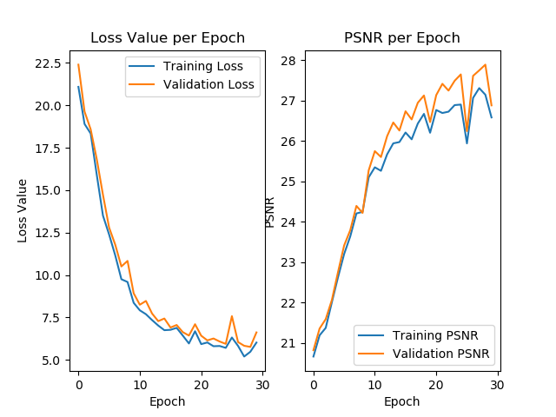
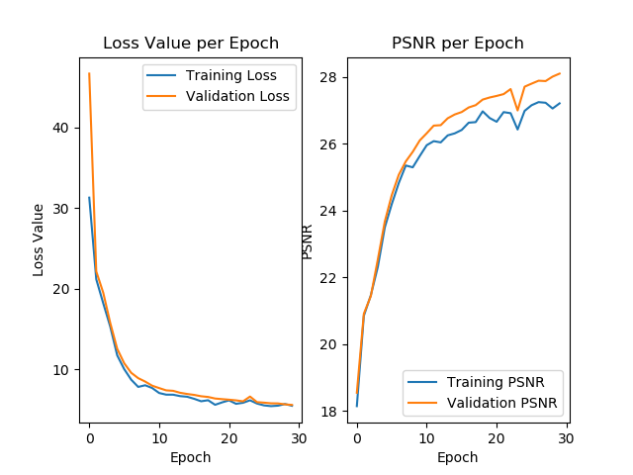
Training Results: 25 Training Images
Smoothing Plus Additive Noise: 4 Blocks vs 8 Blocks
4 Blocks
8 Blocks

Slide 42
Discussion: Number of Samples Impact on Training
As you increase the number of training samples, the model will converge faster. This is shown by the changes in the loss curve. With 500 samples, the convergence is evident very early, Where as with 25 samples, the convergence does not occur until approximately epoch ‘20’.

Slide 43
Discussion: Number of Layers Impact on Training
In all cases, 8 block networks give slightly higher PSNR and slightly lower loss at convergence than 4 block networks.

Slide 44
Training Parameters for the Next 4 Slides
Learning Rate: 1e-4
200 epochs
Noise Parameters:
No Noise
Additive Gaussian White (AGW) Noise Only
Motion Blurring Plus AGW
Gaussian Smoothing Plus AGW
Number of Training Samples:
25 Samples
Number of Convolutional Layers:
4 Blocks
8 Blocks

Slide 45
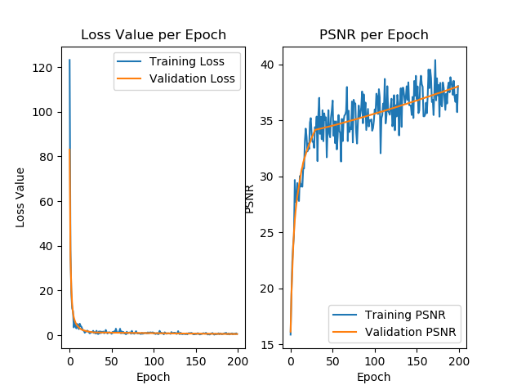
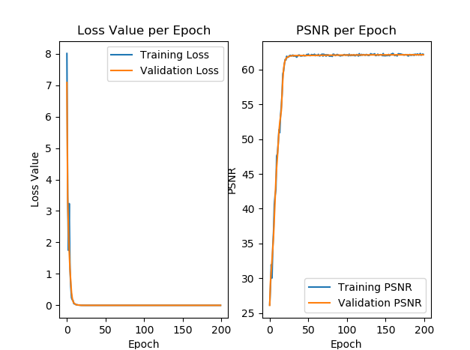
Training Results: Learning Rate: 1e-4
No Noise: 4 Blocks vs 8 Blocks
4 Blocks
8 Blocks

Slide 46


Training Results: Learning Rate: 1e-4
Additive Noise Only: 4 Blocks vs 8 Blocks
4 Blocks
8 Blocks

Slide 47


Training Results: Learning Rate: 1e-4
Motion Plus Additive Noise: 4 Blocks vs 8 Blocks
4 Blocks
8 Blocks

Slide 48


Training Results: Learning Rate: 1e-4
Smoothing Plus Additive Noise: 4 Blocks vs 8 Blocks
4 Blocks
8 Blocks

Slide 49
Discussion: Learning Rate Impact on Training
As you decrease the learning rate, the rate of convergence certainly slows down. It takes more epochs to converge on a stable value.
The difference between a 4 layer network and an 8 layer network becomes more evident. 8 block networks converge much more quickly and to a higher PSNR and lower loss than 4 block networks for a lower learning rate.

Slide 50
Homework 4 Requirements
Q1 [60pts]: Design a VDSR like residual learning network, with 4 and 8 residual blocks, and a predictor that is just Gaussian smoothing with sigma=2.0, i.e. your residual learning target, is im1 - imfilter(im1, h3) as in the example code;
Q2[40pts]: Show restoration results in the format below:
Your report must involve:
Introduction
Explanation of key lines
Hyper-parameters adjustment (learning rate, number of layers, etc..)
Training results on one dataset two types of noisy images:
The loss curve of training & validation set (figure)
The average PSNR curve of validation set (figure)
The results on testing set between wiener filer and VDSR in the comparison.
Result analysis
Conclusion

Slide 51
Testing Code
Files involved in Testing:
TestHW4.py
testNoiseGenerator.py

Slide 52

From TestHW4.py
Include the needed packages
Set the location of CNN and the test images
Tell the program HOW to find the GPU
Set the training parameters

Slide 53

From TestHW4.py
Clear the GPU
Initialize the network model
Load a Pretrained Network to the model
Print the model architecture for verification

Slide 54

From TestHW4.py
Load the image into memory
Add noise that aligns with the trained model
Calculate the PSNR of noisy image
Apply the Wiener Filter and calculate PSNR
Apply the CNN to generate the residual image
Subtract the residual image from the input image
Calculate PSNR

Slide 55

From TestHW4.py
Plot the original image
Plot the Noisy Image
Plot the filtered images

Slide 56

From testNoiseGenerator.py
Import the correct libraries
Select the type of noise to generate

Slide 57

From testNoiseGenerator.py
Generate Gaussian White Noise
Generate Motion Noise
Generate Gaussian Smoothing Noise

Slide 58

From testNoiseGenerator.py
Generate Motion Point Spread Function
Generate Gaussian Smoothing Point Spread Function

Slide 59
Testing Parameters:
For Testing, we chose the models trained with 500 training images since they seemed to have the best convergence.
We tested our network against Lena and Cameraman
For Additive Gaussian White Noise
Mean: 0
Std.: 2.0
For Motion Noise/Blurring
Angle from 0: 11
Length: 21
For Gaussian Smoothing Noise
Mean: 0
Std.: 2.0

Slide 60


Testing: No Noise 4 Layers

Slide 61


Testing: No Noise 8 Layers

Slide 62


Testing: AGW Only 4 Layers

Slide 63


Testing: AGW Only 8 Layers

Slide 64


Testing: Motion Plus AGW 4 Layers

Slide 65


Testing: Motion Plus AGW 8 Layers

Slide 66


Testing: Smoothing Plus AGW 4 Layers

Slide 67


Testing: Smoothing Plus AGW 8 Layers

Slide 68
Discussion: Testing – CNN
In all cases, the CNN was able to filter out the Gaussian White Noise and increase the PSNR of the noisy image. This is because the CNN is capable of learning the residual noise characteristics and filtering them out effectively.
AGN: the CNN effectively filters out the AGN only images and produces strong filtering results.
Motion: the CNN seem to be least effective on Motion plus AGN. This is because motion noise is more complex and requires a deeper network and the noise parameters are more effectively learned if AGN is NOT present.
Smoothing: the CNN very effectively denoises the images when AGN and Gaussian smoothing noise are present

Slide 69
Discussion: Testing – Wiener Filter
In all cases, the Wiener Filter ‘seemed’ to perform poorly on filtering out any type of noise. The PSNR was lower than the original noisy image. This performance is because the Wiener Filter works best on Motion Noise Only
AGN: Qualitatively, the Wiener Filter produced a cleaner image than the noisy counterpart. However, the PSNR appears to be lower.
Motion: Qualitatively, the Wiener Filter produced a cleaner image than the noisy counterpart. However, the PSNR appears to be lower.
Smoothing: Qualitatively, the Wiener Filter produced a cleaner image than the noisy counterpart. However, the PSNR appears to be lower.

Slide 70
Conclusion: CNN vs Wiener Filter
CNN
Wiener Filter
Filters out AGN effectively
Filters out Gaussian Smoothing effectively
Does not perform as well on Motion noise, but will still increase the PSNR of the image.
Produces good qualitative results, though the PSNR does not back it up.
Performs moderately for AGN
Performs better for Motion noise
Performs moderately for Gaussian Smoothing
In all cases, the CNN outperformed the Wiener Filter for Image Denoising.

Slide 71
Homework 4 Requirements
Q1 [60pts]: Design a VDSR like residual learning network, with 4 and 8 residual blocks, and a predictor that is just Gaussian smoothing with sigma=2.0, i.e. your residual learning target, is im1 - imfilter(im1, h3) as in the example code;
Q2[40pts]: Show restoration results in the format below:
Your report must involve:
Introduction
Explanation of key lines
Hyper-parameters adjustment (learning rate, number of layers, etc..)
Training results on one dataset two types of noisy images:
The loss curve of training & validation set (figure)
The average PSNR curve of validation set (figure)
The results on testing set between wiener filer and VDSR in the comparison.
Result analysis
Conclusion

